Slide 1
Data Structures and Algorithm
Course Code: CS-201
Topic: Linked List/ Single link list
Course Instructor: Habiba arshad

Slide 2
Goals for today
To study:
Linked list
Singly/ one-way linked list

Slide 3
CLO Covered
CLO1: Explain the fundamentals of data structure as well as algorithms that operate on them

Slide 4
Problem With Array
Fixed Length (Occupy a Block of memory) [Are also called Dense List]
To expand an Array
create a new array, longer in size and
copy the contents of the old array into the new array
Insertion or Deletion

Slide 5
Solution
Attach a pointer to each item in the array, which points to the next item
This is a linked list
A data item plus its pointer is called a node

Slide 6
Linked List
A linked list, or one-way list, is a linear collection of data elements , called nodes, where the linear order is given by means of pointer

Slide 7
Linked List
A linked list is a linear data structure, in which the elements are not stored at contiguous memory locations.
The elements in a linked list are linked using pointers (entity that points to the next element)

Slide 8
Linked List
A linked list is a series of connected nodes, where each node is a data structure. A linked list can grow or shrink in size as the program runs.
If new data need to be added to a linked list, the program simply allocates another node and inserts it into the series.
If a particular piece of data needs to be removed from the linked list, the program deletes the node containing that data.

Slide 9
Linked List
Linked list consists of nodes where each node contains a data field and a reference(link) to the next node in the list.
Each node is divided into two parts
First part contains the information of the element, and
Second part called the link field or next pointer field contains the address of the next node in the list.
Linked list is the second most-used data structure after array.
Notes:
This creates a chain where the first node points to the second node, the second node points to the third node, and so on.

Slide 10
Linked Lists
node
A
data
pointer
Each node contains at least
A piece of data (any type)
Pointer to the next node in the list

Slide 11
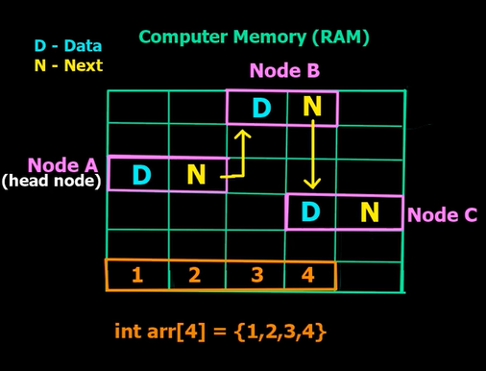
Linked List Representation in Memory

Slide 12
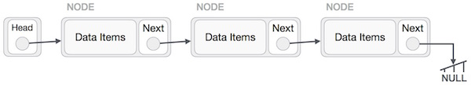
The Composition of Linked Lists
The following list has nodes, plus a pointer known as the list head.
The head simply points to the first node in the list. Each node, in turn, points to the next node in the list.
The first node points to the second node, which points to the third node. Because the third node is the last one in the list, it points to the NULL address (address 0).
This is usually how the end of a linked list is signified by letting the last node point to NULL.

Slide 13
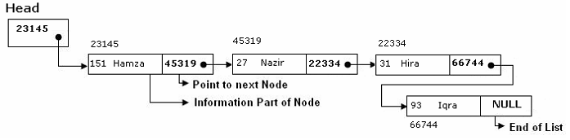
The Head is a special pointer variable which contains the address of the first node of the list. If there is no node available in the list then Head contains NULL value that means, List is empty.
The left part of the each node represents the information part of the node, which may contain an entire record of data (e.g. ID, name, marks, age etc). the right part represents pointer/link to the next node.
The next pointer of the last node is null pointer signal the end of the list

Slide 14
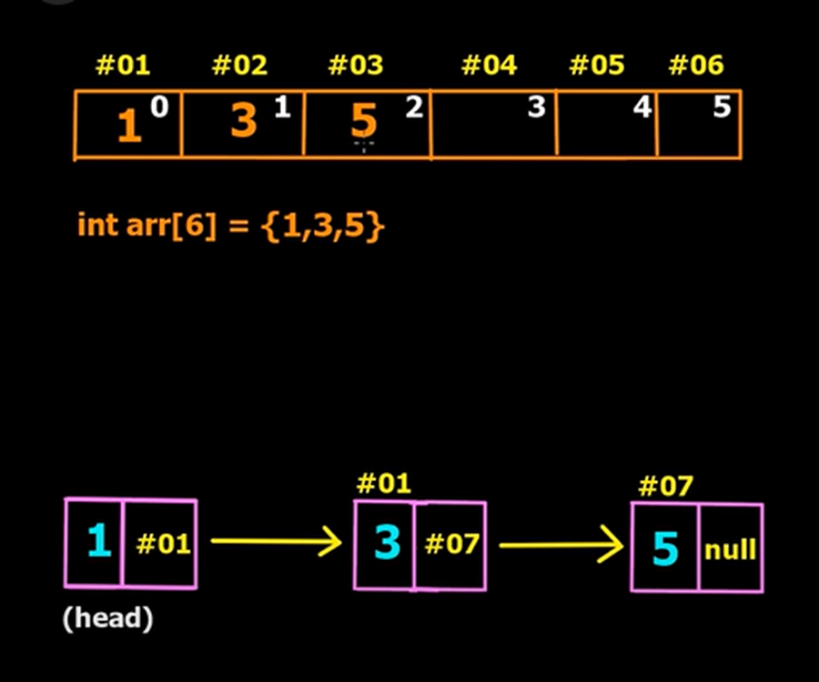
Advantages:
List of data can be stored in arrays but linked structures (pointers) provide several advantages.
A linked list is appropriate when the number of data elements to be represented in data structure is unpredictable. It also appropriate when there are frequently insertions & deletions occurred in the list.
Linked lists are dynamic, so the length of a list can increase or decrease as necessary.

Slide 15
Disadvantages
Random access is not allowed. We have to access elements sequentially starting from the first node.
Extra memory space for a pointer is required with each element of the list.
Not cache friendly. Since array elements are contiguous locations, there is locality of reference which is not there in case of linked list
Notes:
Imagine you have a bookshelf with books. Each book on the shelf represents an employee's information. In the case of an array, all the books are lined up one after another on the shelf, and you can easily reach for any book because they are all right next to each other. This is similar to how an array stores data in contiguous memory locations, making it easy to access.
Now, consider a linked list. Instead of all the books being on the same shelf, each book has a note inside it telling you where the next book is located. So, to find a specific book, you have to keep jumping from one book to the next, and then to the next, and so on, following the notes. This constant moving around can be time-consuming and less efficient because you're not taking advantage of the fact that the books (or data) are stored close together in one place.
So, when we say a linked list is "not cache-friendly," we mean that it doesn't take full advantage of the nearby, contiguous memory locations. In a way, it's like having to jump around more to find things, which can slow down your access to data when compared to an array where everything is neatly lined up.

Slide 16
Applications of Linked list
Image viewer
Navigation in web browser
Music player
No. of users visiting a website
Web browser history

Slide 17
Types of Linked List
Following are the various types of linked list.
Singly Linked List − Item navigation is forward only.
Doubly Linked List − Items can be navigated forward and backward.
Circular Linked List − Last item contains link of the first element as next and the first element has a link to the last element as previous.

